Slide 1
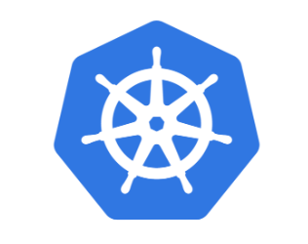
Kubernetes for beginners
- Reshu Vishwakarma

Slide 2
Contents
DAY 2
Volumes
Config Maps and Secret
RBAC
Security Context
Network Policies
Taints and tolerations
K8s cloud services
DAY 1
Definition
Architecture
Ways to create K8s objects
Pods, Deployments, services and Replica Set
Jobs and CronJobs
Labels and selectors
Resource requests and limits

Slide 3
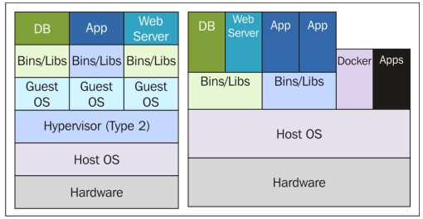
KUBERNETES
Open-source container orchestration engine for automating deployment, scaling and management of containerized applications
Cloud native technology
Build by Google
Configured on nodes (machine – physical or virtual)

Slide 4
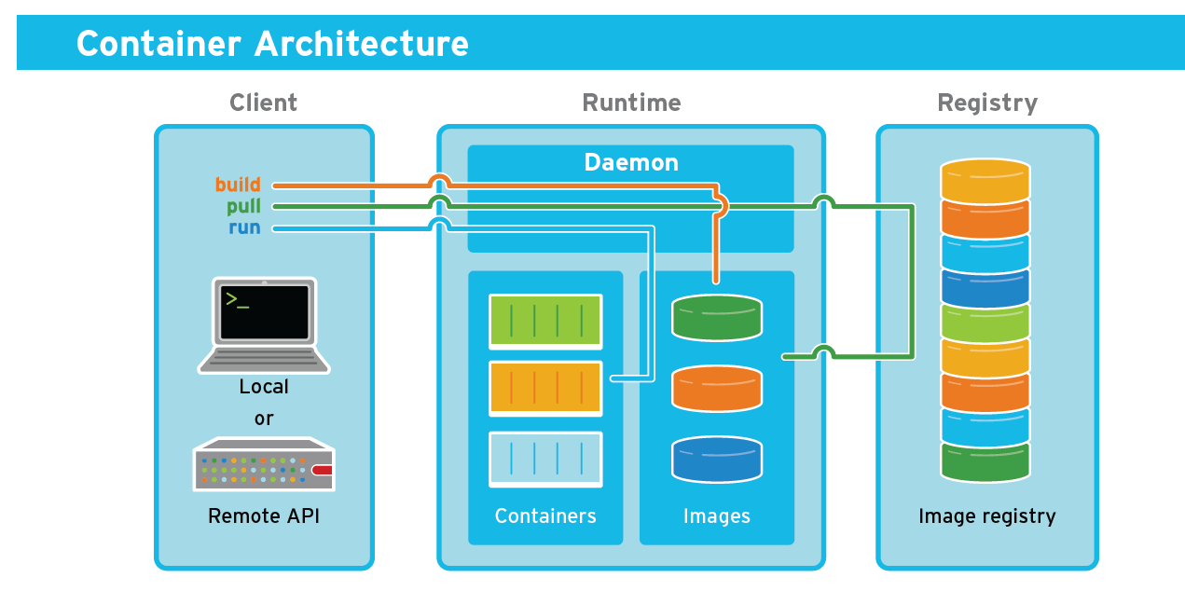
CONTAINER
Running instance of the image, where image is the package or template

Slide 5
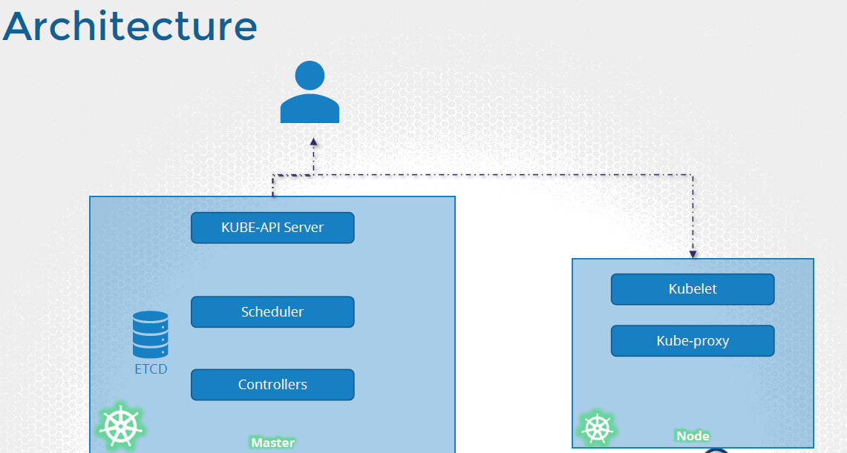
ARCHITECTURE
API Server – Front end for k8s
ETCD – Distributed reliable key-value store used by k8s to store all data used to manage the cluster
Scheduler – Distributes work or containers across the nodes
Controller – Brain behind orchestration- responsible for decision making such as to bring up new containers in case of failure
Kubelet – Ensures that containers are running as expected
Kube-proxy - network proxy that runs on each node in a Kubernetes cluster. It provides network connectivity to Kubernetes services and enables communication between different pods in the cluster.
Container runtime – Underlying software that runs container (docker)

Slide 6
Creation of K8s Objects-
1. Imperative (using CLI commands)
2. Declarative (using YAML files)
YAML Files
K8s uses YAML files as input for creation of objects such as pods, deployments, replicas, services, etc.
K8s definition file always contains 4 top level fields-
apiVersion
kind
metadata
spec

Slide 7
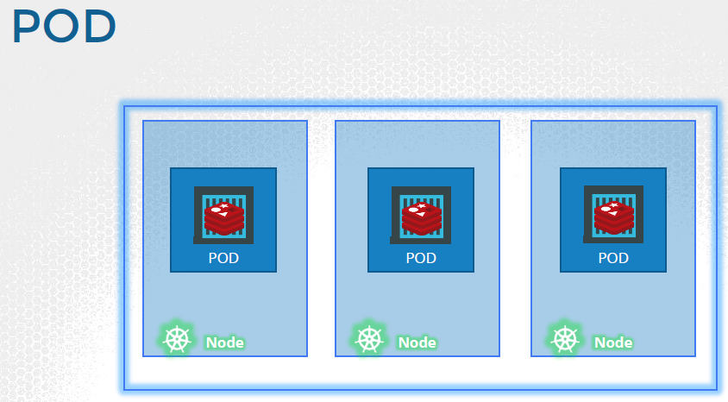
POD
Smallest Kubernetes deployable unit of computing that can be created and managed in k8s cluster
Encapsulates container/s into k8s object
Single instance of application

Slide 8
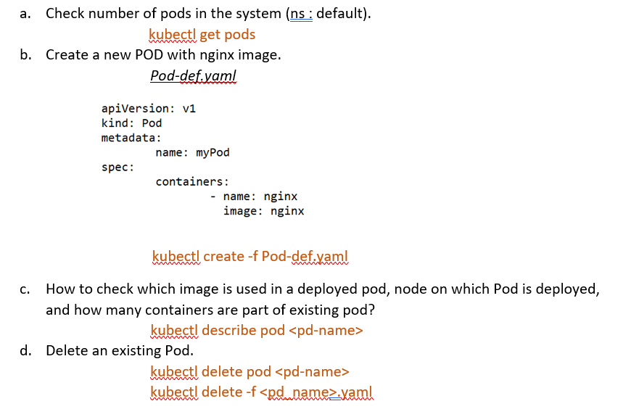

Slide 9
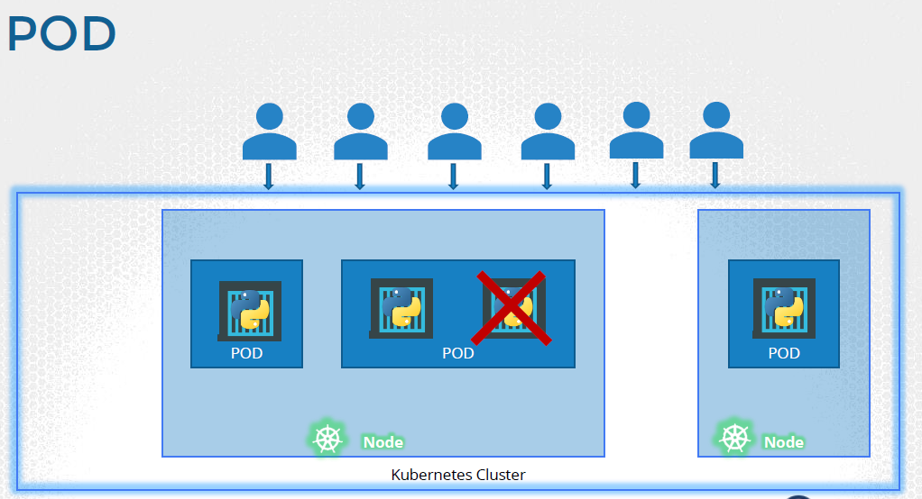
Question:
Number of users accessing your application has increased.
Solution:
Add additional instances of your web application to share the load.

Slide 10
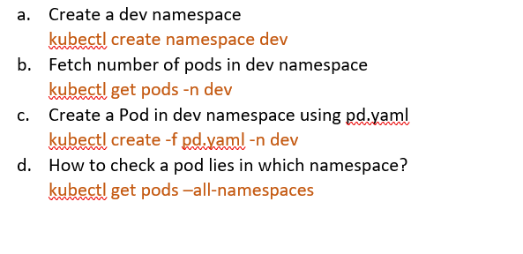
Namespace:
Isolates group of resources within a single cluster
kubectl create namespace <name> → creates namespace
Kubectl get ns → lists all namespaces present

Slide 11
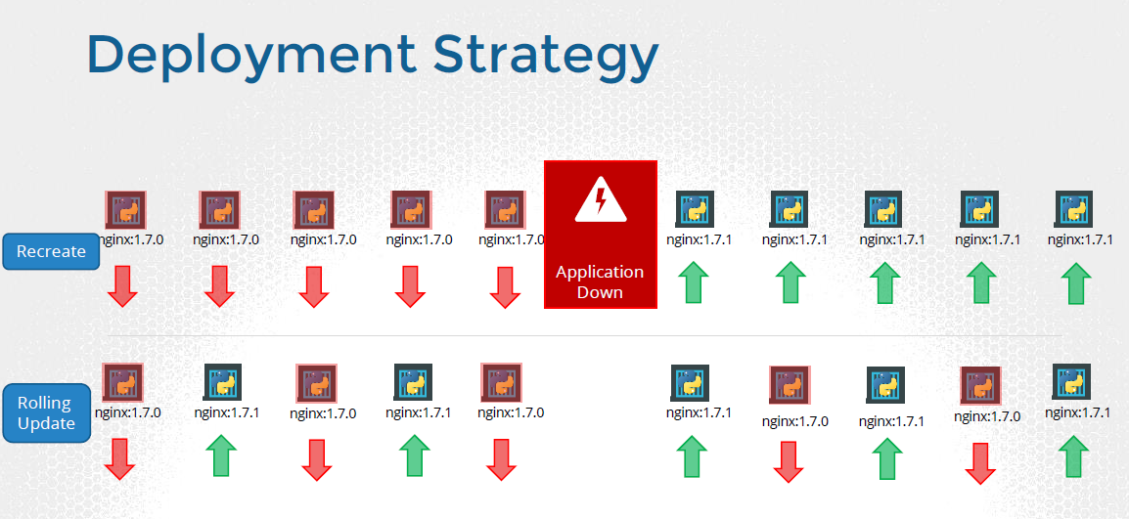
Deployments:
Provides declarative updates for pod and replica sets
kubectl rollout undo deploy <name> → rollback
Rolling update results to zero downtime deployment, as it updates the pod instances with new ones using incremental approach.
Edit image in deployment
kubectl set image deployment/<deploy_name> <container-name>=<image-name>

Slide 12
Replica sets:
Maintains a stable set of replica pods at any given time
kubectl scale deploy <name> --replicas=<n>
If you delete one pod created from rs. What will happen?
rs will create a new Pod automatically
Services:
Abstract access to Kubernetes pods
Kubectl expose deploy <DeployName> --port=<>
Types- ClusterIP, NodePort, ExternalName, and LoadBalance
ClusterIP: This service exposes the application on a cluster-internal IP address, which can be used only within the cluster. This is the default service type.
NodePort: This service exposes the application on a port on each node in the cluster. The node listens on that port, and forwards traffic to the service. This allows external traffic to access the application.
LoadBalancer: This service exposes the application using an external load balancer. This is useful when you have multiple nodes running your application and you want to distribute traffic across them.
ExternalName: This service maps a service name to an external DNS name. This can be used to access services that are not part of your Kubernetes cluster.

Slide 13
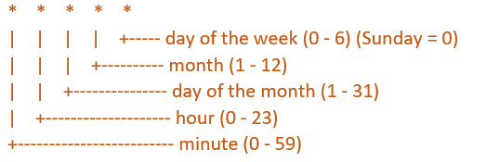
Jobs and Cron Jobs:
These are automated jobs that are useful for creating periodic and recurring tasks, like running backup and sending mails
kubectl create job <name> --image=<>
Kubectl create cj <name> --image=<> --schedule=“* * * * *”

Slide 14
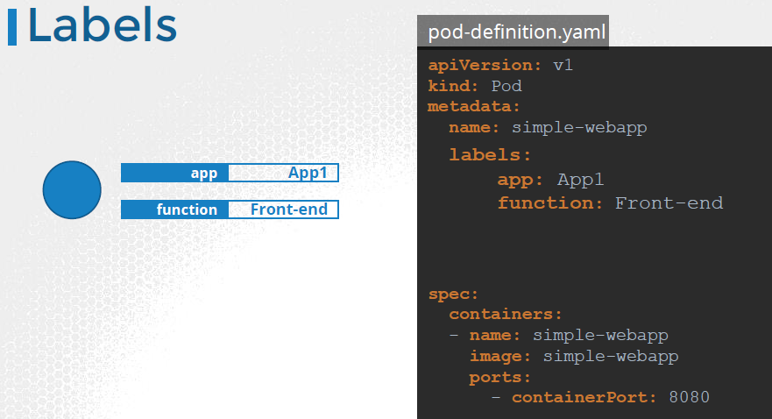
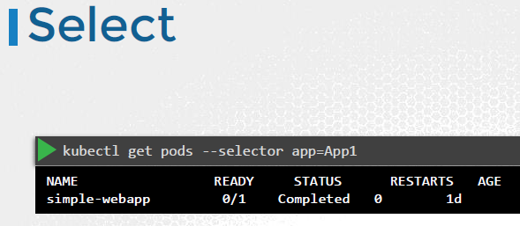
Labels and selectors-
Label is a key-value identifying attribute of an object.
Selector is the core grouping primitive in K8s

Slide 15
Resource Requests and Limits:
Defined in POD specification and illustrates how much resources such as CPU and memory a container needs.
Kubernetes scheduler uses them while allocating POD to a particular node.
Kubelet uses these values to ensure that a POD does not use the resources more than the limit specified.
Example:
resources:
limits:
memory: "500Mi"
cpu: "500m"
requests:
memory: "300Mi"
cpu: "250m"

Slide 16
MONITORING
How to view the logs of a pod?
kubectl logs <pd_name>
How to execute shell in a pod?
kubectl exec <pd_name> -I -t <cmd>
POD DESIGN
Fetch pods with the label as env=dev
kubectl get pods - - selector=env=dev
Fecth all Objects in k8s
Kubectl get all
Edit image in deployment
kubectl set image deployment/<deploy_name> <container-name>=<image-name>

Slide 17
Scenario Based Questions
1. You are deploying a microservices application to Kubernetes, and you have multiple teams responsible for different parts of the application. How would you organize the application's resources to ensure that each team can deploy and manage their components independently?
Organizing an application for multiple teams: You would need to use Kubernetes namespaces and RBAC (role-based access control) to create separate environments for each team, and you might also use Kubernetes labels and selectors to allow each team to manage their own resources.
2. One of your application's Pods is crashing frequently, and you suspect that it is running out of memory. How would you troubleshoot the issue and identify the root cause?
Troubleshooting a crashing Pod: You would need to use Kubernetes logs and events to diagnose the issue, and you might also use tools like kubectl exec or a debug container to explore the Pod's filesystem and processes.
3. You need to deploy a new version of your application to Kubernetes, but you want to minimize downtime and ensure that any in-progress requests are not interrupted. How would you perform a rolling update of the application's Pods?
Performing a rolling update: You would need to use a Kubernetes Deployment object with a rolling update strategy to update your application's Pods without downtime.

Slide 18
QUIZ TIME

Slide 19
1. What is Kubernetes?
a. A programming language
b. A container orchestration platform
c. A cloud storage service
d. A network protocol
ANS - B
2. What is a Kubernetes Cluster?
a. A group of containers running on a single node
b. A group of nodes that work together to run containers
c. A set of containers that share the same storage volume
d. A set of containers that communicate with each other through a service
ANS - B
3. What is a Kubernetes Node?
a. A physical or virtual machine where containers are deployed
b. A logical grouping of containers
c. A service that provides access to a set of containers
d. A component that manages the deployment and scaling of containers
ANS - A

Slide 20
4. What is a Kubernetes Master?
a. The primary node in a cluster that controls the scheduling and deployment of containers
b. A container that runs a specific application or service
c. A service that provides access to a set of containers
d. A logical grouping of containers
ANS - A
5. What is a Kubernetes Service?
a. A group of containers running on a single node
b. A logical grouping of containers
c. A service that provides access to a set of containers
d. A component that manages the deployment and scaling of containers
ANS - C
6. What is a Kubernetes Controller?
a. Brain behind orchestration
b. A service that provides access to a set of containers
c. A group of nodes that work together to run containers
d. A physical or virtual machine where containers are deployed
ANS - A

Slide 21
7. What is the purpose of a Kubernetes API server?
a. To store the configuration of the Kubernetes objects
b. To manage the scheduling of containers across nodes
c. To provide access to the Kubernetes API
d. To manage the deployment and scaling of containers
ANS - C
8. What is the purpose of a Kubernetes etcd?
a. To store the configuration of the Kubernetes objects
b. To manage the scheduling of containers across nodes
c. To provide access to the Kubernetes API
d. To manage the deployment and scaling of containers
ANS - A
9. What is the purpose of a Kubernetes scheduler?
a. To store the configuration of the Kubernetes objects
b. To manage the scheduling of containers across nodes
c. To provide access to the Kubernetes API
d. To manage the deployment and scaling of containers
ANS - B

Slide 22
10. What is the primary purpose of a Kubernetes Pod?
a. To hold and manage one or more containers
b. To provide a persistent storage volume for containers
c. To provide access to external services
d. To manage the scaling of containers
ANS - A
11. Can a Pod have multiple containers?
a. Yes
b. No
ANS - A
12. What is a rolling update in Kubernetes?
A. A deployment strategy where all pods are updated at once
B. A deployment strategy where new pods are created and old ones are deleted in a controlled manner
C. A deployment strategy where pods are updated in batches
D. A deployment strategy where pods are updated randomly
ANS - B

Slide 23
13. What is the purpose of a Kubernetes Service?
A Kubernetes object that defines a desired state for a set of pods
A Kubernetes object that defines a set of volumes for a pod
A Kubernetes object that exposes a set of pods as a stable network endpoint
A Kubernetes object that manages the deployment and scaling of pods
ANS - C
14. What is the purpose of a Kubernetes Replica Set?
a. To ensure that a specified number of replicas of a Pod are running
b. To provide access to a set of containers
c. To manage the deployment and scaling of containers
d. To store the configuration of the Kubernetes objects
ANS - A
15. What is the primary difference between a Kubernetes Job and a CronJob?
a. A Job runs once, while a CronJob runs on a schedule
b. A Job runs on a schedule, while a CronJob runs once
c. A Job is used to manage the deployment and scaling of containers, while a CronJob is used to run Pods to completion
d. There is no difference between a Job and a CronJob
ANS - A

Slide 24
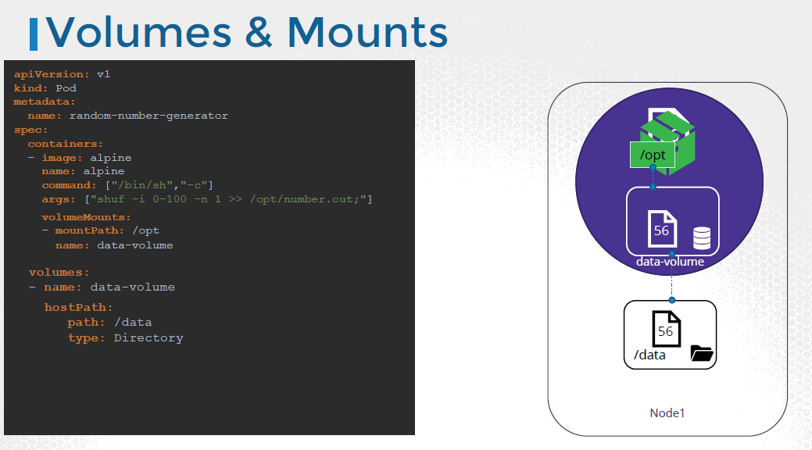
Volumes
Storage cluster resource which is independent of lifecycle of pod that uses it
To persist data processed by the Pods, we attach a volume to the Pods when they are created.
The data processed by the pod is now placed in this volume, thereby retaining it permanently. Even if the pod is deleted, the data generated or processed by it remains.

Slide 25
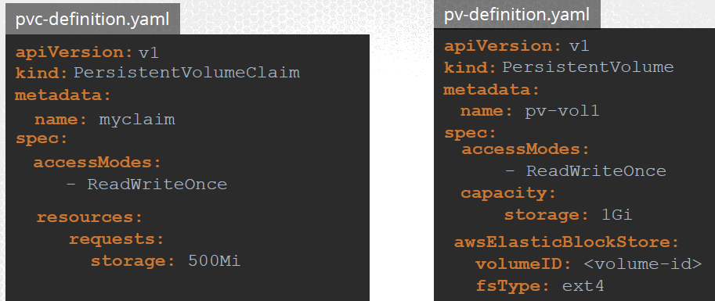
Persistent Volume
A Cluster wide pool of storage volumes configured by an Administrator, to be used by users deploying applications on the cluster.
Persistent Volume Claim
Request by the user for the storage
Every Persistent Volume Claim is bound to a single Persistent volume.
During the binding process, kubernetes tries to find a Persistent Volume that has sufficient Capacity as requested by the Claim, and any other requested properties such as Access Modes, Volume Modes.

Slide 26
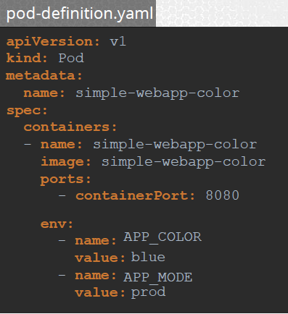
Environment Variables
When you have a lot of pod definition files, it will become difficult to manage the environment data stored within various files.
Config Maps
We can env information out of the pod definition file and manage it centrally using Configuration Maps.
Config Maps are used to pass configuration data in the form of key value pairs in Kubernetes.
When a POD is created, inject the Config Map into the POD, so the key value pairs are available as environment variables for the application hosted inside the container in the POD.

Slide 27
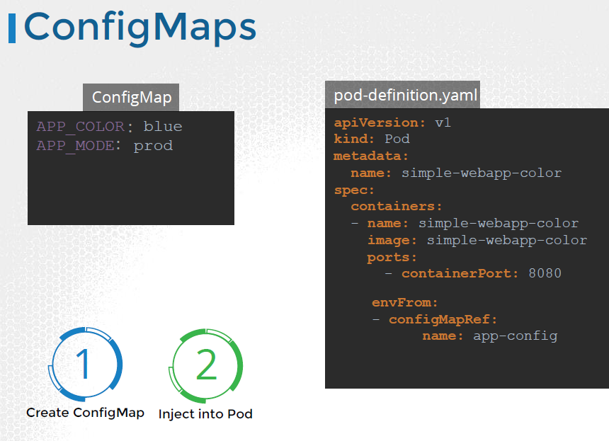

Slide 28
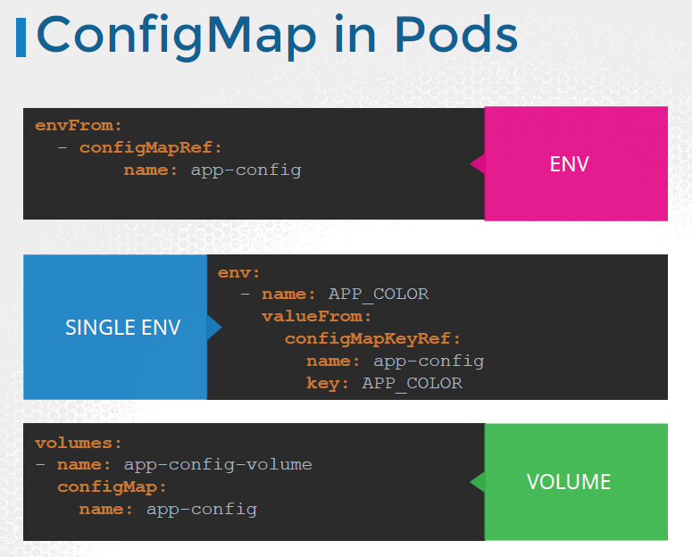

Slide 29
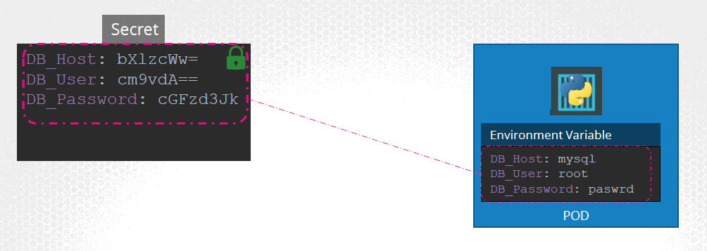
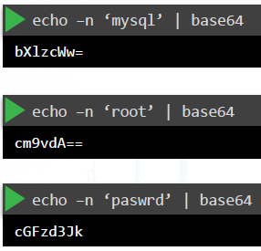
Secrets
Secrets are used to store sensitive information, like passwords or keys.
They are similar to configMaps, except that they are stored in an encoded or hashed format.

Slide 30
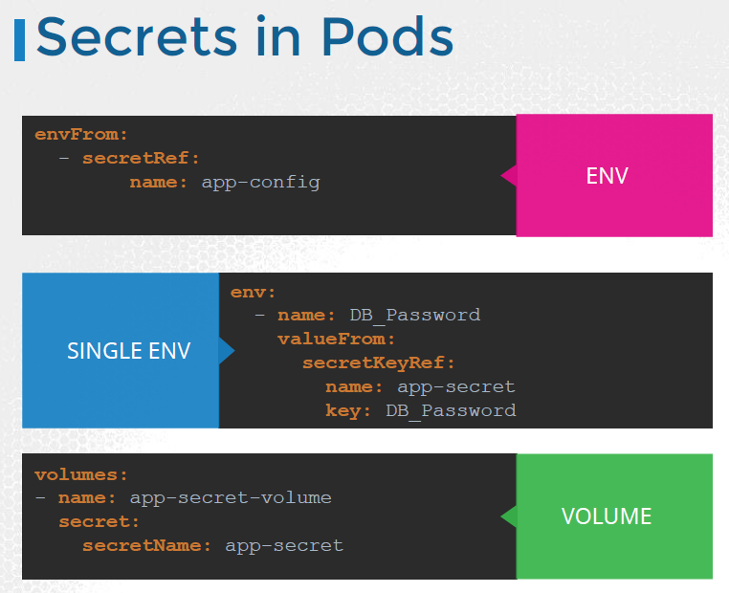

Slide 31
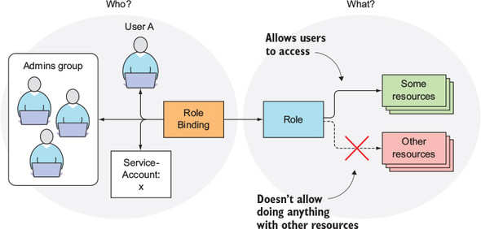
RBAC

Slide 32
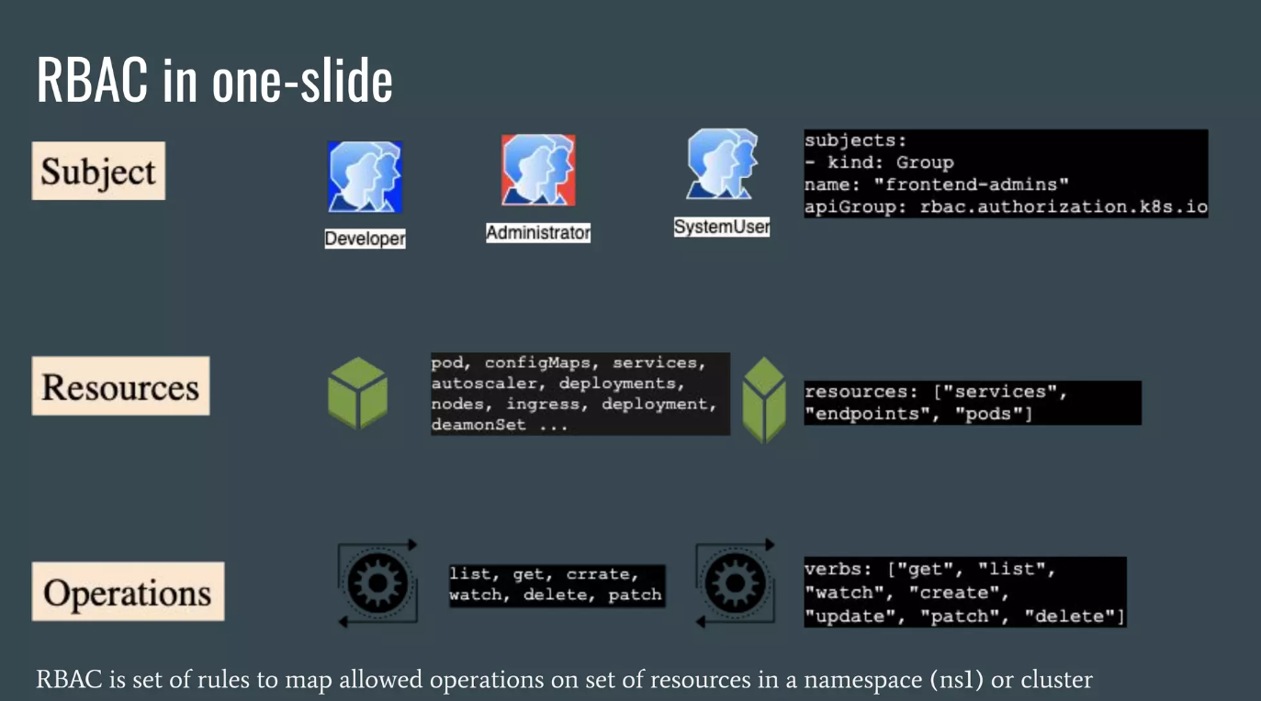

Slide 33
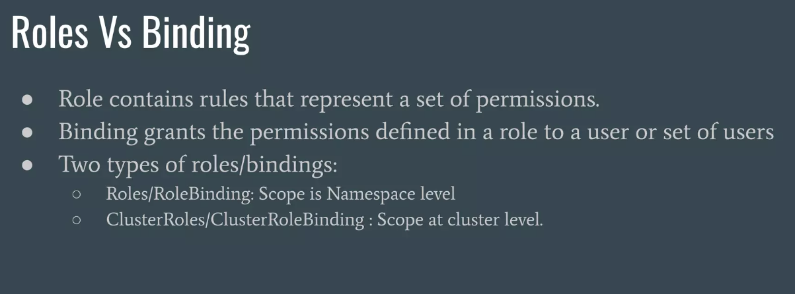

Slide 34
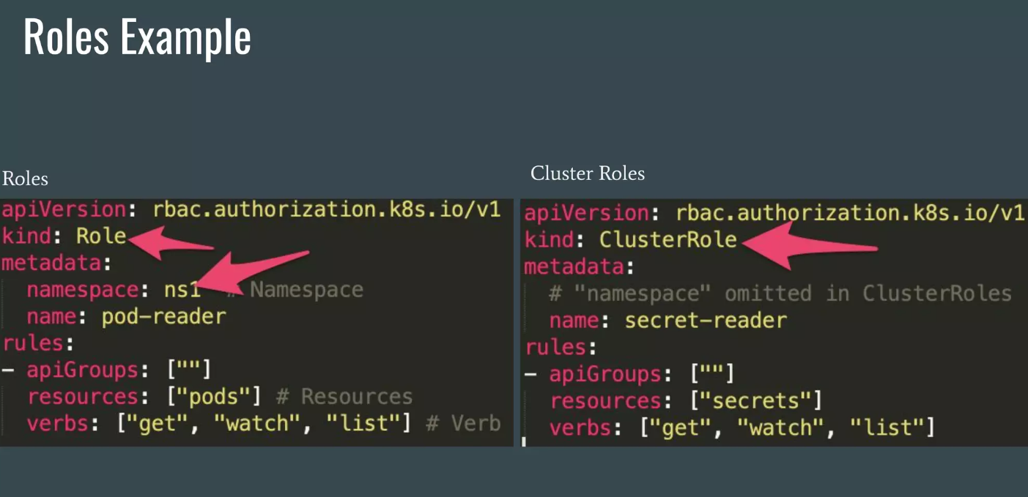

Slide 35
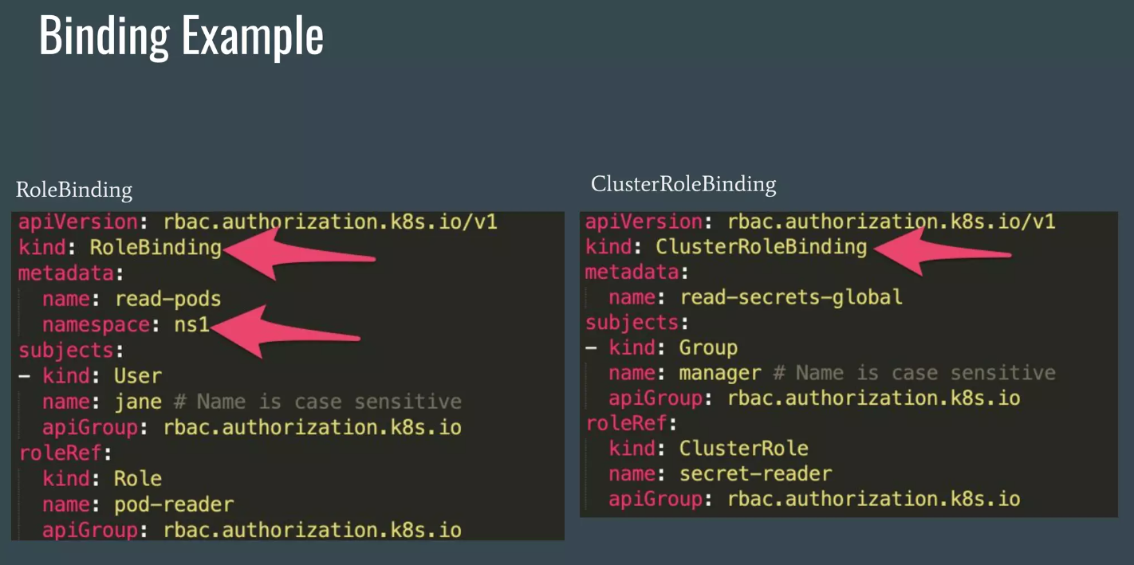

Slide 36
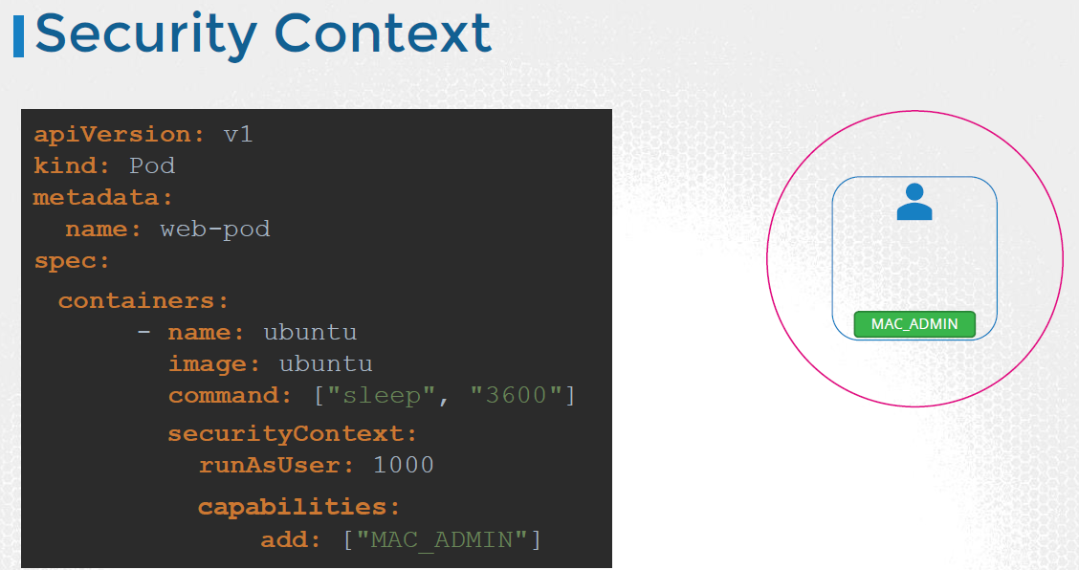
Security Context:
Allows to control security attributes of Pod or container.
It provides a way to set different security-related settings such as user and group IDs, Linux capabilities

Slide 37
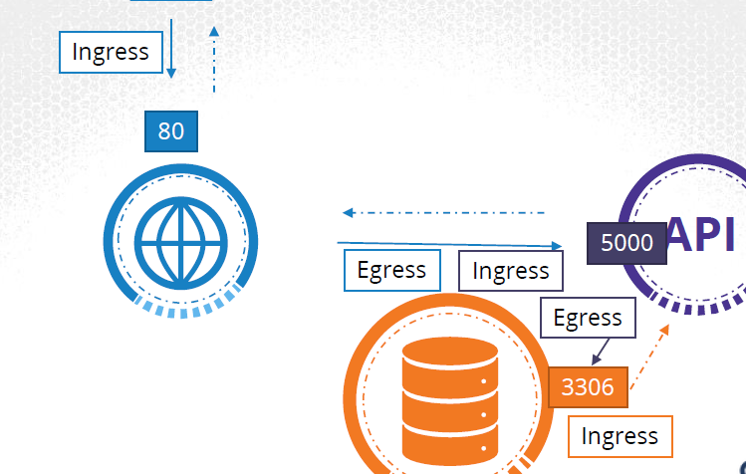
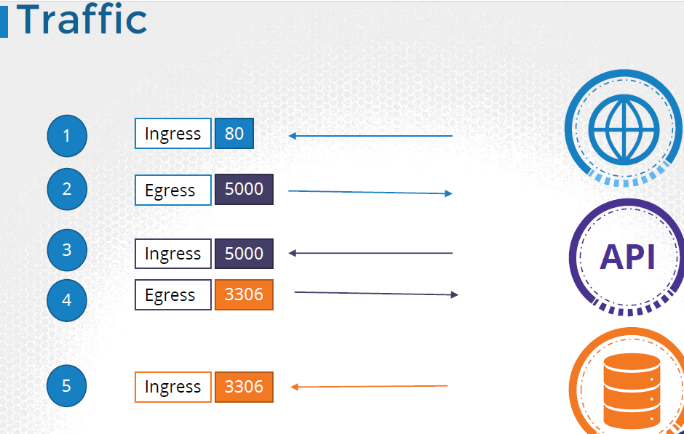
Network Policies- is a feature that allows you to control the network traffic between different pods in a Kubernetes cluster. It enables you to define and enforce rules that specify which pods can communicate with each other, and on which ports and protocols.

Slide 38
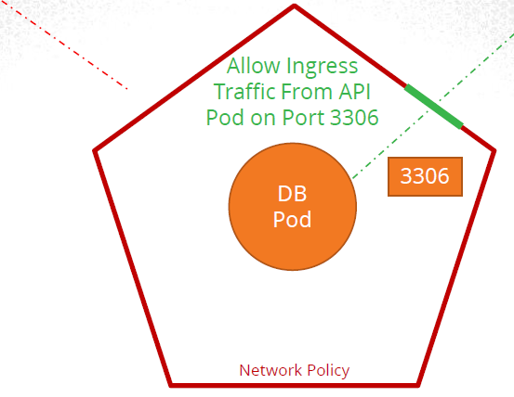
Scenario:
What if we do not want the front-end web server to be able to communicate with the database server directly? Say for example, the security teams and audits require you to prevent that from happening?
Solution:
Implement a Network Policy to allow traffic to the dbserver only from the apiserver.

Slide 39
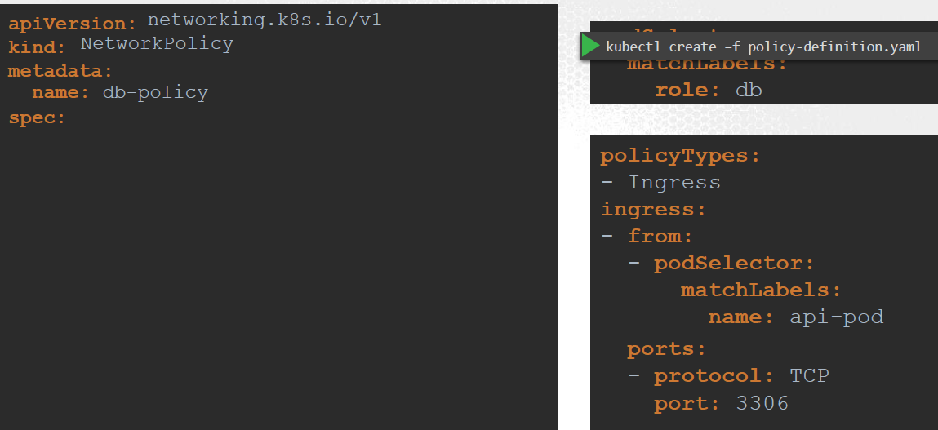
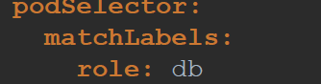
A network policy is associated with a set of pods using labels, and it applies only to the pods that match the specified labels.

Slide 40
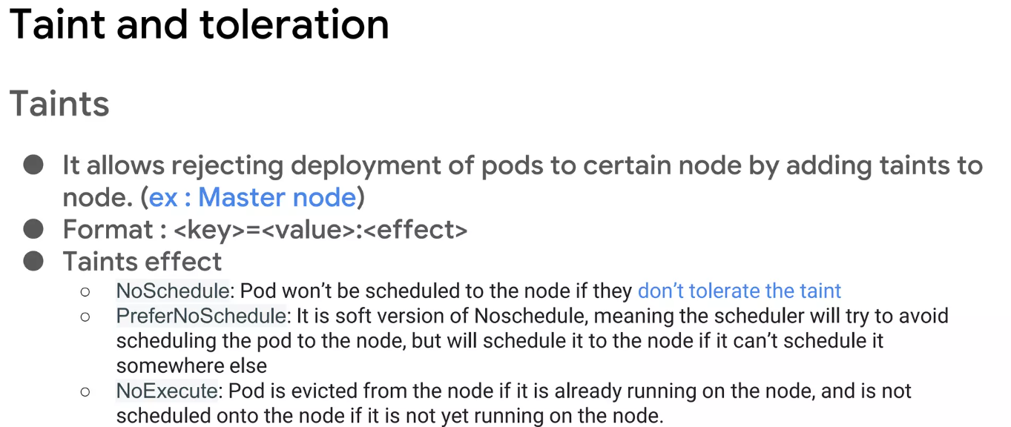
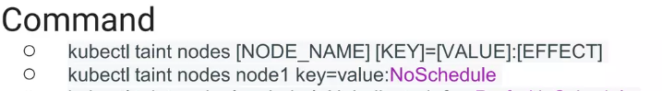

Slide 41
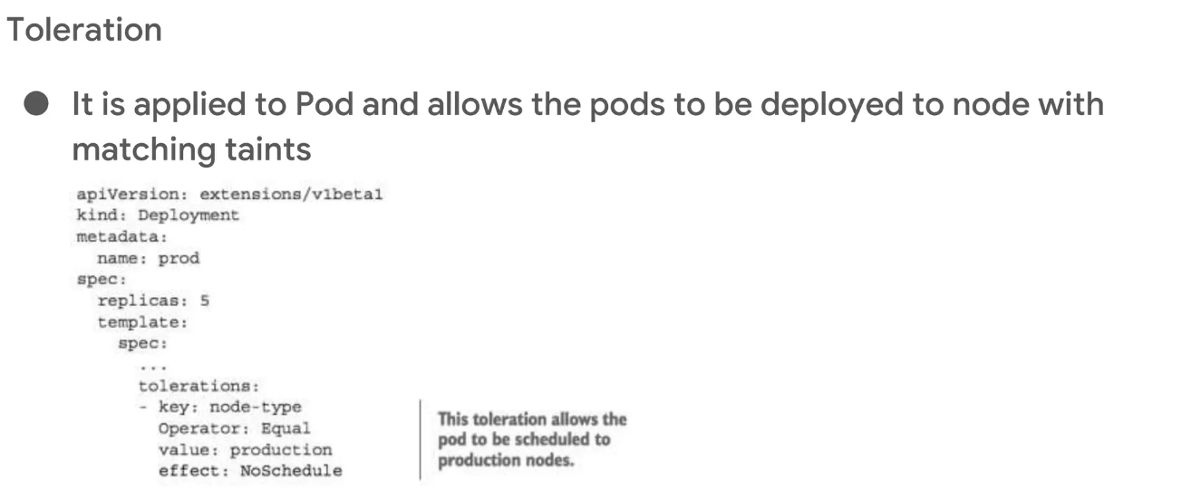

Slide 42
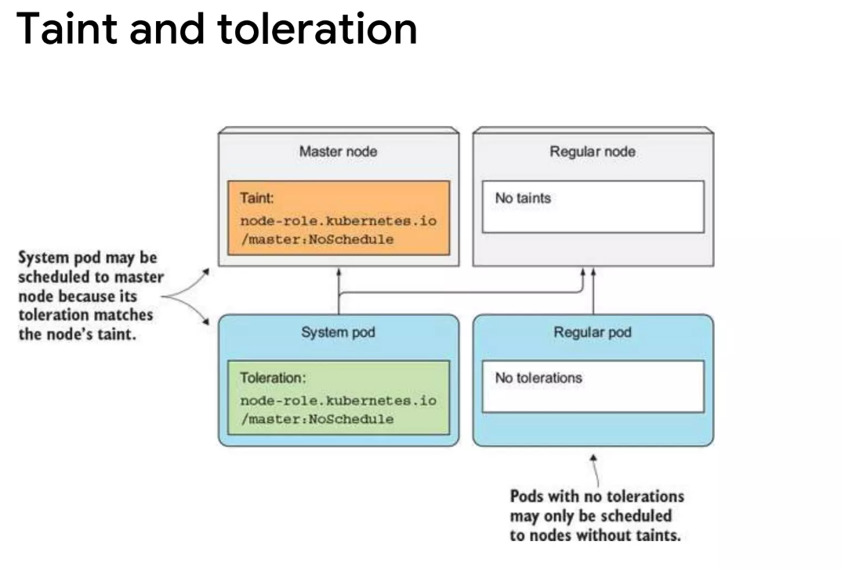

Slide 43
Cloud K8s Services –
EKS, AKS, and GKE are all managed Kubernetes services provided by Amazon Web Services (AWS), Microsoft Azure, and Google Cloud Platform (GCP), respectively.
Platform: EKS runs on AWS infrastructure, AKS runs on Azure infrastructure, and GKE runs on Google Cloud infrastructure.
Pricing: All three services charge for the Kubernetes control plane, worker nodes, and other resources consumed. However, pricing structures may differ depending on the specific features and resources used.
Scalability: All three services allow for easy scaling of Kubernetes clusters, with support for automatic scaling of worker nodes.
Integration: EKS integrates well with other AWS services, AKS integrates well with other Azure services, and GKE integrates well with other GCP services. Each service offers a range of integrations and APIs to support various workflows and applications.
Security: All three services provide strong security features, including support for role-based access control, network policies, and other security mechanisms to control access to the Kubernetes cluster and its resources.
Support: Each service provides support for Kubernetes issues, as well as support for the cloud platform and infrastructure.

Slide 44
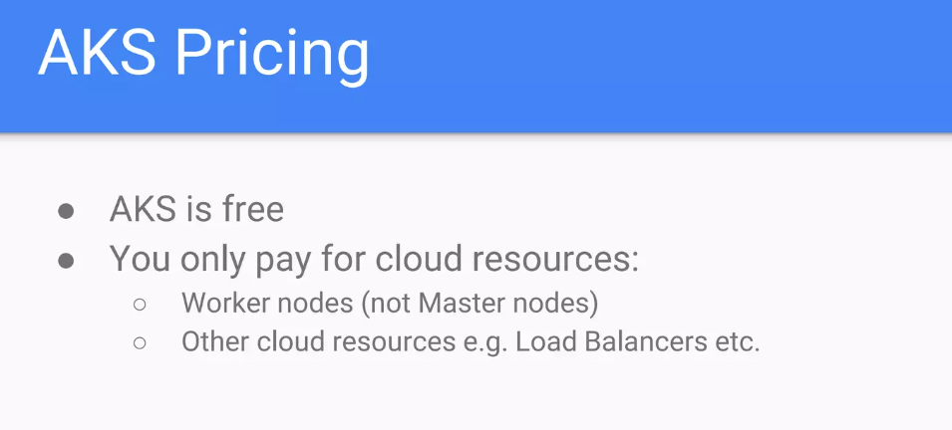

Slide 45
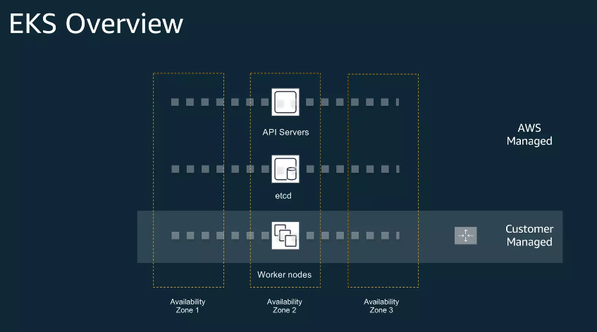
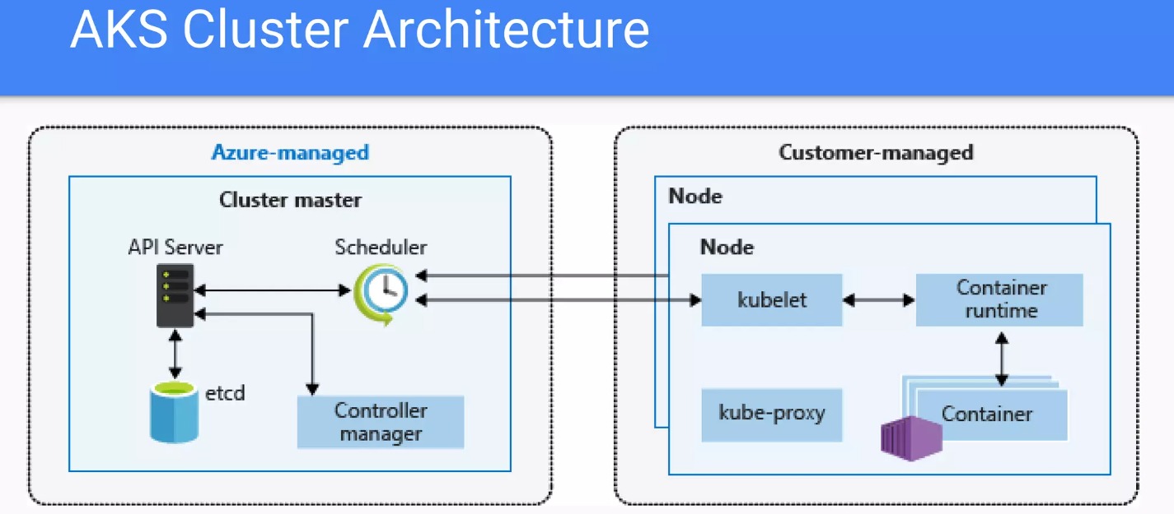

Slide 46
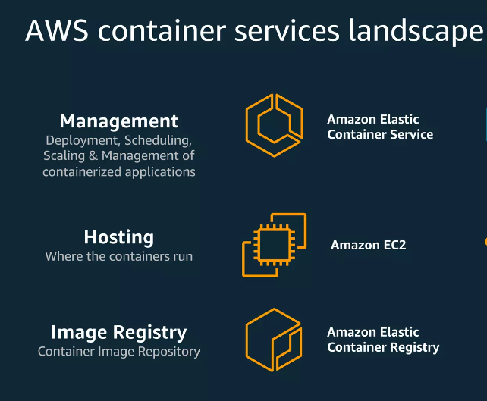

Slide 47
Scenario Based Questions
Your application needs to communicate with a database that is running outside of Kubernetes. How would you configure your application's Pods to connect to the database securely and reliably?
Connecting to an external database: You would need to use Kubernetes secrets to store the database credentials, and you might also use a Service and an Endpoint object to expose the database to your application's Pods.
You need to configure your application to scale automatically based on incoming traffic. How would you use Kubernetes Horizontal Pod Autoscaling (HPA) to dynamically scale the number of Pods based on CPU or memory utilization?
Scaling with Horizontal Pod Autoscaling (HPA): You would need to set up a Kubernetes HPA object that automatically scales the number of Pods based on CPU or memory utilization, and you might also use a Kubernetes Ingress or Service object to distribute traffic to your Pods.
Command- kubectl autoscale deployment/replicaset <deployment/replicaset-name> --cpu-percent=<target-percent> --min=<min-replicas> --max=<max-replicas>
Your application needs to process data from an external message queue that requires a long-lived connection. How would you deploy a message consumer as a Kubernetes Pod, and how would you ensure that the Pod can maintain a persistent connection to the message queue?
Connecting to an external message queue: You would need to use a Kubernetes Pod or Deployment object to run the message consumer, and you might also use a Kubernetes ConfigMap to store the message queue configuration and a Kubernetes Service object to provide a stable network address.

Slide 48
QUIZ TIME

Slide 49
1. What is a Kubernetes resource request?
a. The minimum amount of a resource that a container requires to run
b. The maximum amount of a resource that a container requires to run
c. The total amount of a resource available on a Kubernetes node
ANS - A
2. What is a Kubernetes resource limit?
a. The minimum amount of a resource that a container requires to run
b. The maximum amount of a resource that a container requires to run
c. The total amount of a resource available on a Kubernetes node
ANS - B
3. What is a Kubernetes Volume?
a. A container image
b. A logical host for containers
c. A persistent storage location for a container
d. A Kubernetes node
ANS - C

Slide 50
4. What is a Kubernetes Network Policy?
a. A configuration option that sets the minimum and maximum resource requests and limits for a container
b. A configuration option that provides a container with a specific security context
c. A configuration option that sets up network policies for a container
d. A configuration option that specifies taints and tolerations for a node
ANS - C
5. What is the purpose of a Kubernetes Volume?
a. To provide a persistent storage location for a container
b. To manage the deployment and scaling of containers
c. To store the configuration of the Kubernetes objects
d. To provide access to a set of containers
ANS - A
6. What is a Kubernetes ConfigMap?
a. A container image
b. A Kubernetes object that stores configuration data in key-value pairs
c. A logical host for containers
d. A persistent storage location for a container
ANS - B

Slide 51
7. What is a Kubernetes Security Context?
a. A configuration option that sets the minimum and maximum resource requests and limits for a container
b. Allows to control security attributes of Pod or container.
c. A configuration option that sets up network policies for a container
d. A configuration option that specifies taints and tolerations for a node
ANS - B
8. What is a Kubernetes Secret?
a. A logical host for containers
b. A Kubernetes object that stores sensitive data in key-value pairs
c. A container image
d. A persistent storage location for a container
ANS - B
9. What is the purpose of a Kubernetes Taint?
a. To specify the resources required by a container
b. To specify the resources available on a node
c. To mark a node as un-schedulable
d. To provide a container with a specific security context
ANS - C

Slide 52
10. Which cloud service provides a fully-managed Kubernetes offering?
Amazon Web Services (AWS)
b) Microsoft Azure
c) Google Cloud Platform (GCP)
d) All of the above
ANS - D
11. Why is Kubernetes important?
It allows for easy deployment and management of containerized applications
b) It provides an easy way to manage virtual machines
c) It is a database management system
d) It is a cloud storage platform
ANS - A
12. What is the role of Kubernetes in cloud-native architecture?
It provides a way to manage containers in a cloud environment
b) It is used to manage virtual machines in the cloud
c) It is a cloud storage platform
d) It is a database management system
ANS - A

Slide 53
13. What is the purpose of a Kubernetes NetworkPolicy?
a. To allow traffic between all pods in a Kubernetes cluster
b. To deny traffic between all pods in a Kubernetes cluster
c. To specify rules for allowing or denying traffic between pods in a Kubernetes cluster
d. To manage the state of the Kubernetes control plane components
ANS - C
14. What is the recommended way to store sensitive information such as passwords or API keys in a Kubernetes cluster?
a. As environment variables in a pod definition file
b. In a Kubernetes secret object
c. In a Kubernetes configMap object
d. In a plaintext file on the host system
ANS - B
15. What does RBAC stand for in Kubernetes?
Role-Based Authorization Control
Role-Based Access Control
Resource-Based Access Control
d. Resource-Based Authorization Control
ANS - B

Slide 54

References:
https://kubernetes.io/docs/home/
https://kodekloud.com/

